Slide 1
Lab 3 - Diabetic Retinopathy Detection
視網膜資料classification
Department of Computer Science, NCTU
TA Yu-Chuan Chuang

Slide 2
Important Rules
Important Date :
Report Submission Deadline: 4/18 (Thu) 12:00 p.m.(中午12點)
Demo date: 4/18 (Thu)
Turn in :
Experiment Report (.pdf)
Source code (.py)
Notice: zip all files in one file and name it like「DLP_LAB3_your studentID_name.zip」, ex: 「DLP_LAB3_0656608_莊祐銓.zip」

Slide 3
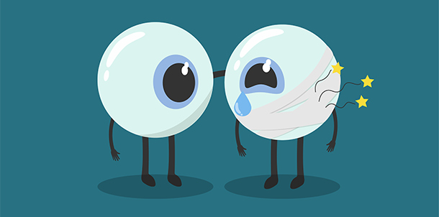
Lab Objective
In this lab, you will need to analysis diabetic retinopathy (糖尿病所引發視網膜病變) in the following three steps.
Step 1. You need to write your own custom DataLoader through PyTorch framework.
Step 2. You need to classify diabetic retinopathy grading via the ResNet [1].
Step 3. You have to calculate the confusion matrix to evaluate the performance.
Source: http://www.commonhealth.com.tw/article/article.action?nid=66150

Slide 4
Requirements
Implement the ResNet18、ResNet50 architecture and load parameters from a pretrained model
Compare and visualize the accuracy trend between the pretrained model and without pretraining in same architectures, you need to plot each epoch accuracy (not loss) during training phase and testing phase.
Implement your own custom DataLoader
Calculate the confusion matrix and plotting

Slide 5
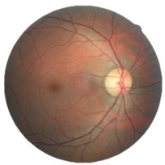
Dataset - Diabetic Retinopathy Detection (kaggle)
Diabetic retinopathy is the leading cause of blindness in the working-age population of the developed world.
This dataset provided with a large set of high-resolution retina images taken under a variety of imaging conditions. Format: .jpeg
Reference : https://www.kaggle.com/c/diabetic-retinopathy-detection#description
Class .
0 - No DR 1 - Mild 2 - Moderate 3 - Severe 4 - Proliferative DR

Slide 6
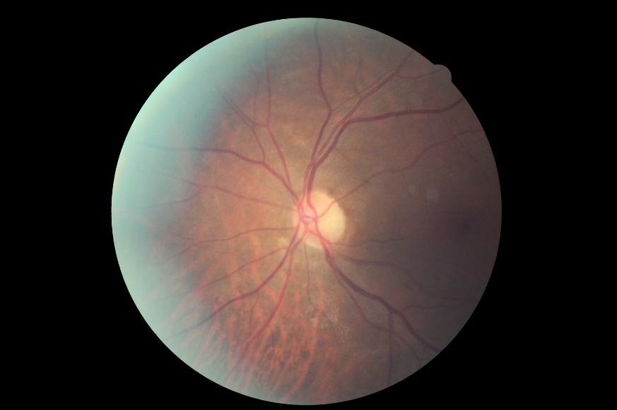
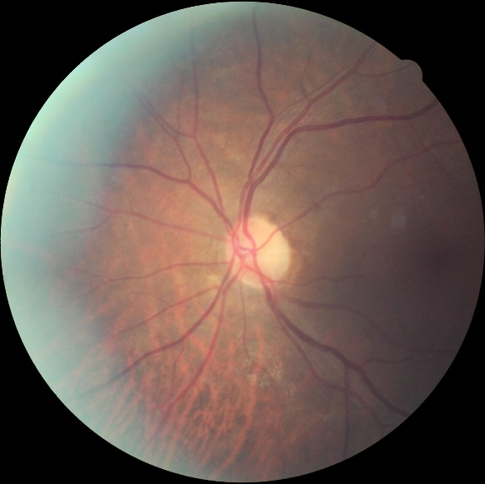
Prepare Data
28,099 images for training
7025 for testing
The image resolution is 512x512 and has been preprocessed.
Input: [B, 3, 512, 512] Output: [B, 5] Ground truth: [B]
Download link:
https://drive.google.com/open?id=1RTmrk7Qu9IBjQYLczaYKOvXaHWBS0o72
4752 x 3168
512 x 512
Notes:
補一張前後照 沒有CROP 黑框

Slide 7
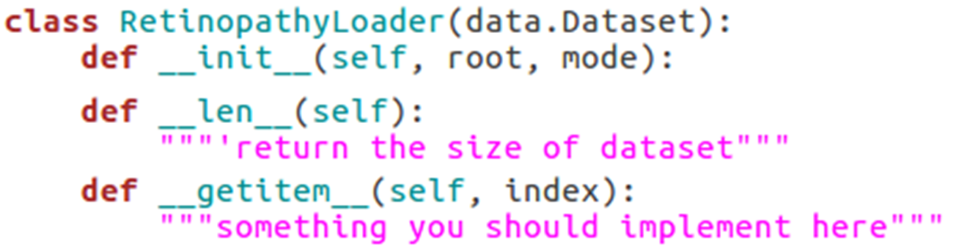
Dataloader
Implement your own custom DataLoader
Below is the skeleton that you have to fill to have a custom dataset, refer to “dataloader.py”

Slide 8
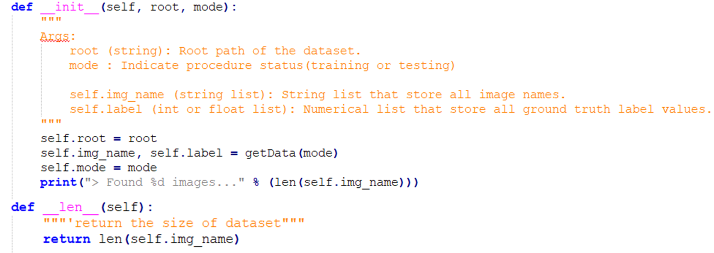
Prepare Data
儲存所有image的檔案名稱和label

Slide 9
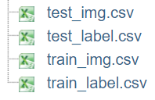
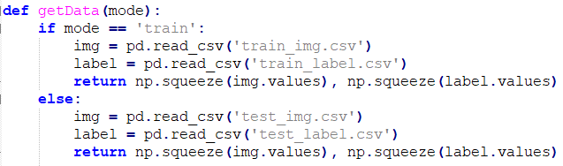
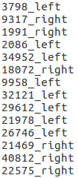
Prepare Data
Image Format: .jpeg
Please do not sort !!!
Notes:
補個裡面內容

Slide 10
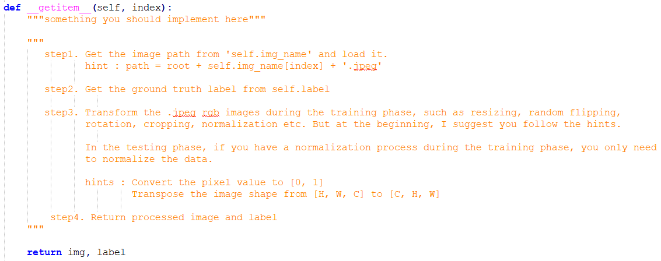
Prepare Data
整個patch一個一個取出，通常假設一次做一件事

Slide 11
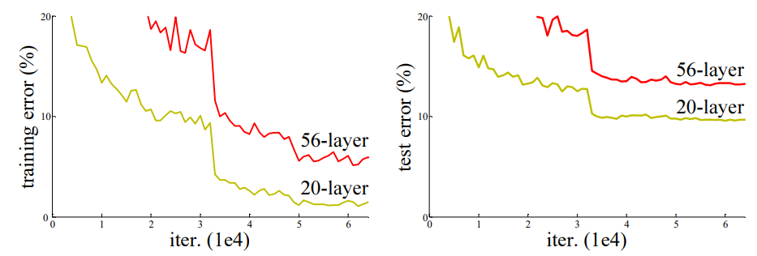
ResNet
ResNet (Residual Network) is the Winner of ILSVRC 2015 in image classification, detection, and localization, as well as Winner of MS COCO 2015 detection, and segmentation

Slide 12
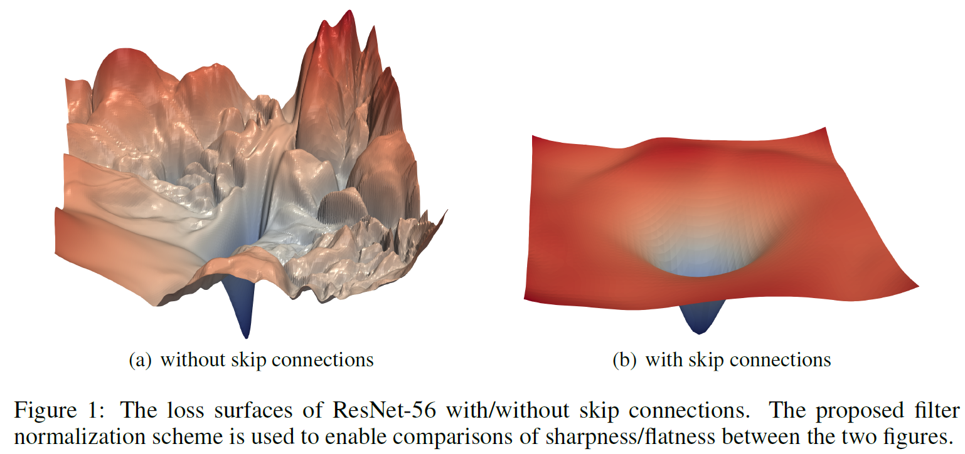
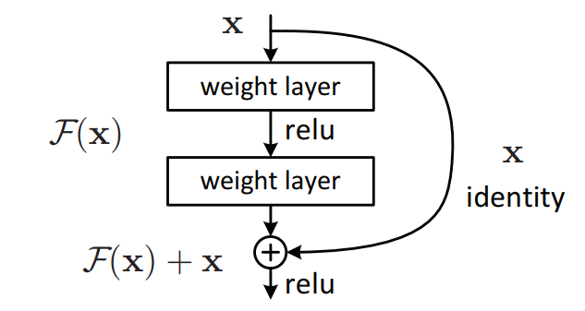
ResNet
To solve the problem of vanishing/exploding gradients, a skip / shortcut connection is added to add the input x to the output after few weight layers as below
Source: Li, Hao, et al. "Visualizing the loss landscape of neural nets." Advances in Neural Information Processing Systems. 2018.

Slide 13
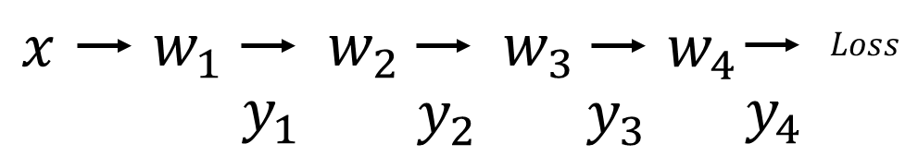
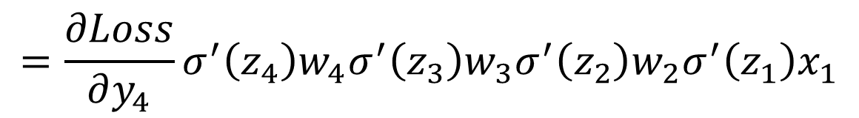
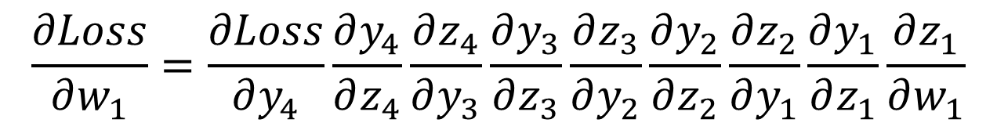
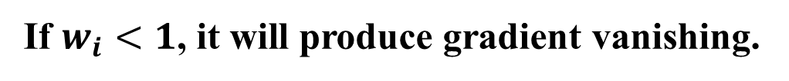
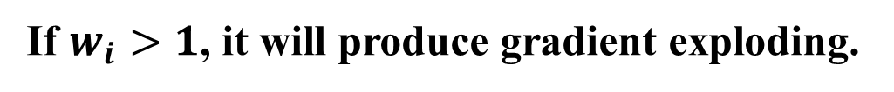
ResNet
ResNet can avoid vanishing gradient problem
$$\frac{∂Loss}{∂w_{1}}=\frac{∂Loss}{∂y_{4}}\frac{∂y_{4}}{∂z_{4}}\frac{∂z_{4}}{∂y_{3}}\frac{∂y_{3}}{∂z_{3}}\frac{∂z_{3}}{∂y_{2}}\frac{∂y_{2}}{∂z_{2}}\frac{∂z_{2}}{∂y_{1}}\frac{∂y_{1}}{∂z_{1}}\frac{∂z_{1}}{∂w_{1}}$$
$$=\frac{∂Loss}{∂y_{4}}σ^{′}\left(z_{4}\right)w_{4}σ^{′}\left(z_{3}\right)w_{3}σ^{′}\left(z_{2}\right)w_{2}σ^{′}\left(z_{1}\right)x_{1}$$
If $w_{i}>1$, it will produce gradient exploding.
If $w_{i}<1$, it will produce gradient vanishing.

Slide 14
ResNet
ResNet can avoid vanishing gradient problem

Slide 15
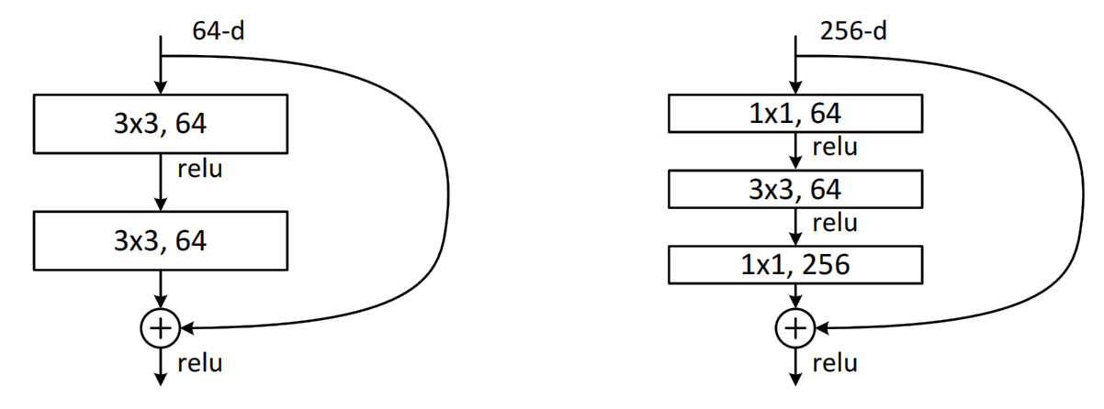
ResNet
ResNe18(Basic block), ResNet50(Bottleneck block)
Basic block
Bottleneck block

Slide 16
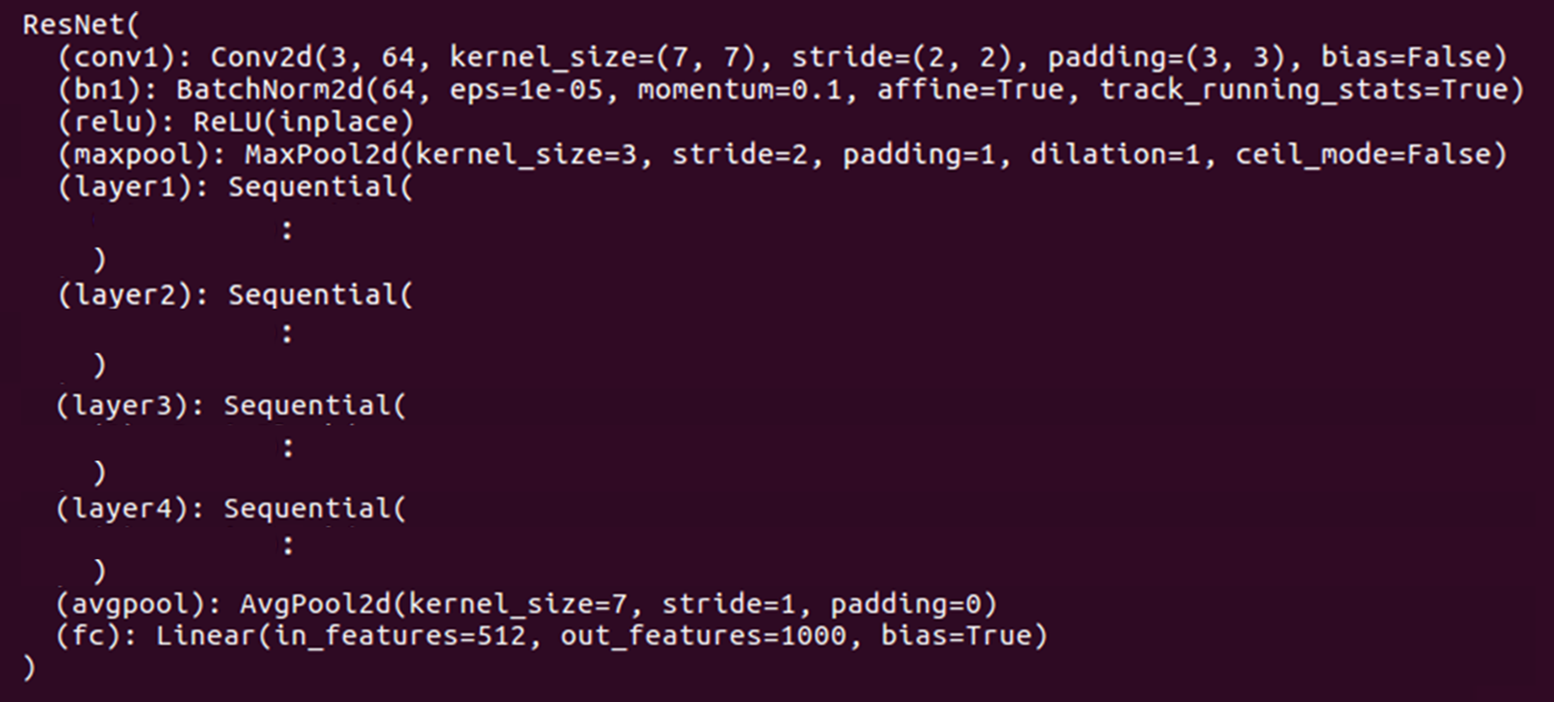
Using Pretrained Model
Using pretrained model by torchvision module
You need to reinitialize the specific layers

Slide 17
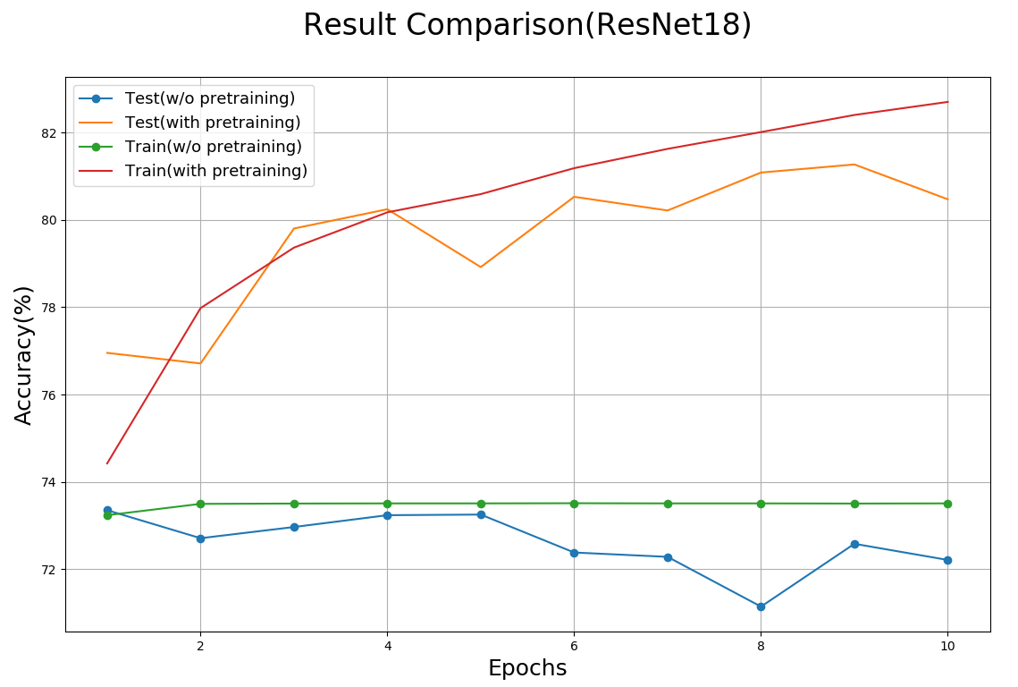
Result Comparison
Compare and visualize the accuracy trend between the pretrained model and without pretraining in same architectures, you need to plot each epoch accuracy (not loss) during training phase and testing phase.
有pretrain
沒有pretrain

Slide 18
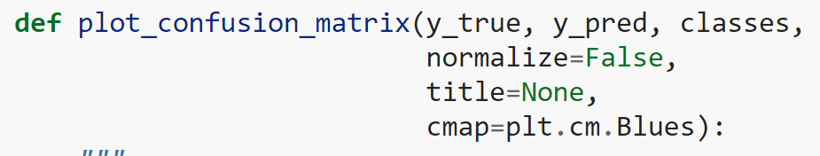
Confusion Matrix
A confusion matrix is a table that is often used to describe the performance of a classification model
y_true : ground truth label array
y_pred: prediction array
Classes: label name [‘0’, ‘1’, ‘2’, ‘3’, ‘4’]
Reference: https://scikit-learn.org/stable/auto_examples/model_selection/plot_confusion_matrix.html#sphx-glr-auto-examples-model-selection-plot-confusion-matrix-py

Slide 19
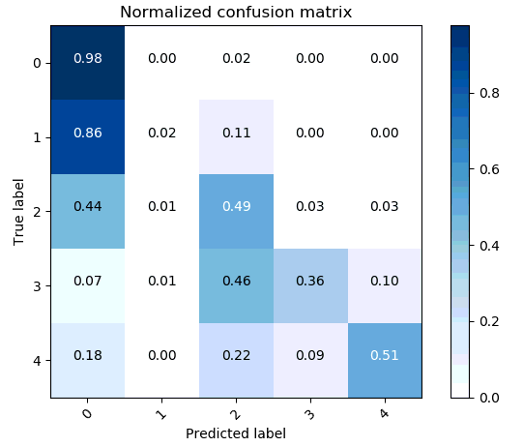
Confusion Matrix
Calculate the confusion matrix and plotting
正常來說斜對角線越深越好

Slide 20
Hyper Parameters
Batch size= 4
Learning rate = 1e-3
Epochs = 10 (resnet18), 5 (resnet50)
Optimizer: SGD Momentum = 0.9 Weight_decay = 5e-4
Loss function: torch.nn.CrossEntropyLoss()
You can adjust the hyper-parameters according to your own ideas.
If you use “nn.CrossEntropyLoss”, don’t add softmax after final fc layer because this criterion combines LogSoftMax and NLLLoss in one single class.

Slide 21
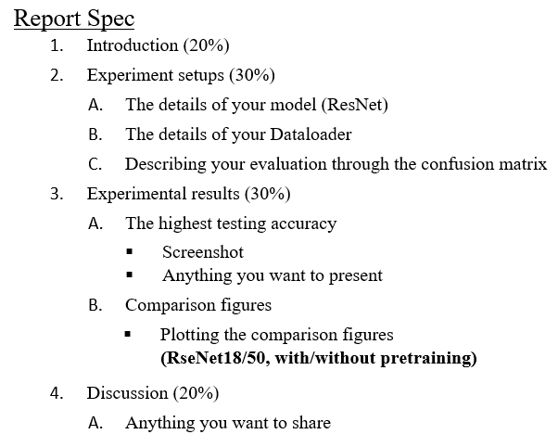
Report Spec

Slide 22
---- Criterion of result (40%) ----
Accuracy > = 82% = 100 pts
Accuracy 80~82% = 90 pts
Accuracy 75~80% = 80 pts
Accuracy < 75% = 70 pts
Score: 40% experimental results + 60% (report+ demo score)
P.S If the zip file name or the report spec have format error, it will be penalty (-5).

Slide 23
Reference
[1] He, Kaiming, et al. "Deep residual learning for image recognition." Proceedings of the IEEE conference on computer vision and pattern recognition. 2016.

